Slide 1
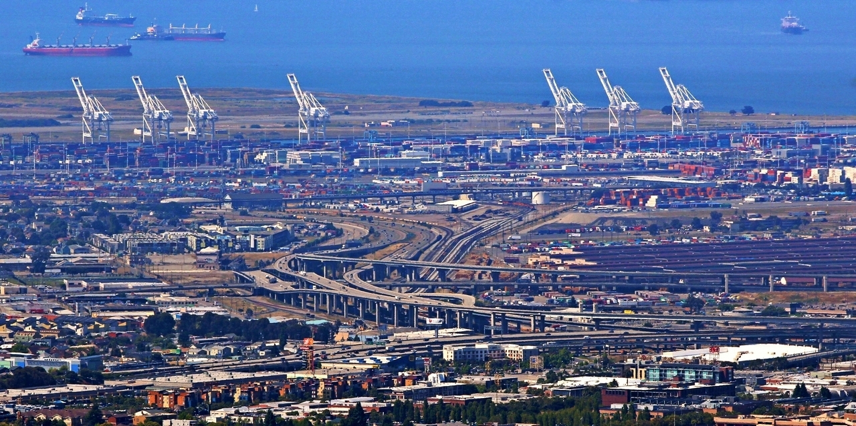
Resources: Open Data and Open-Source Software
Dr. Greg Erhardt
greg.erhardt@uky.edu CE599-002 Spring 2017

Slide 2
Today’s Topics
Using the internet to debug
Open Data & Available Data
Open Source Software
Sorting Through the Noise

Slide 3
Debugging
How to debug small programs
https://ericlippert.com/2014/03/05/how-to-debug-small-programs/
Use Rubber Duck Debugging!

Slide 4
Debugging
How to ask for help
https://stackoverflow.com/help/mcve
Create a Minimal, Complete, and Verifiable example!

Slide 5
Debugging
How to get help
Explain it to a rubber duck
Google it
Ask a peer
Ask the professor
Ask StackOverflow

Slide 6
Debugging
Using Stack Exchange
https://stackoverflow.com/questions/20002503/why-does-a-b-or-c-or-d-always-evaluate-to-true
Your example…

Slide 7

Debugging
But how do you know if the random answers you get on the internet are right?
Test them!

Slide 8
Open Data
Open data is data that can be freely used, re-used and redistributed by anyone - subject only, at most, to the requirement to attribute and sharealike.
-- Open Data Handbook: http://opendatahandbook.org/guide/en/what-is-open-data/
We do not restrict ourselves to open data in this course, but it is worth knowing about because open data are often both valuable and available.

Slide 9
Who publishes data and why?
Open Data: Usually from a government, university or non-profit.
Why?
Transparency
Serve public good
Often subject to Freedom of Information Act (FOIA) anyway.
Notes
What is the transparency of the processing?

Slide 10
Who publishes data and why?
Commercial Data: From a company
Why?
Profit
Sometimes community service or regulation
Notes
What is the transparency of the processing?
Sometimes a “free sample”
Pay attention to data use agreements
Need to pay someone to work on this stuff
Pay for value added or for a ‘data monopoly’?

Slide 11
Data Ownership & Data Privacy
Who owns data about YOU?
Example of Cubic, AirSage, etc.
Need to protect personally identifiable information (PII).
What are valid uses of personal data?
Value of a ‘firewall’

Slide 12
Some Transportation Sources
Freight Analysis Framework: http://faf.ornl.gov/fafweb/
OpenStreetMap: https://www.openstreetmap.org
Rail Waybill: https://www.stb.gov/stb/industry/econ_waybill.html
NYC Taxi Trips: http://www.nyc.gov/html/tlc/html/about/trip_record_data.shtml
http://toddwschneider.com/posts/analyzing-1-1-billion-nyc-taxi-and-uber-trips-with-a-vengeance/#taxi-data
Accessibility Observatory: http://ao.umn.edu/data/
WalkScore: https://www.walkscore.com/professional/walk-score-apis.php
Uber Movement: https://movement.uber.com/cities
OneBusAway: http://onebusaway.org/
GTFS: https://developers.google.com/transit/gtfs/
http://www.gtfs-data-exchange.com/

Slide 13
Some Transportation Sources
Waze: https://www.waze.com/about/dev
Google Maps Distance Matrix API:
https://developers.google.com/maps/web-services/
Here: https://developer.here.com/
INRIX: http://inrix.com/
AirSage: http://www.airsage.com/
As noted previously:
Public Transit: https://www.programmableweb.com/news/how-smart-cities-are-using-apis-public-transport-apis/2014/05/22
Long-Distance Travel: http://www.olery.com/blog/the-best-travel-apis-discover-contribute/
Transportation: https://www.programmableweb.com/category/transportation/api

Slide 14
General Open Data Resources
US Census: http://www.census.gov/
Federal Open Data: https://www.data.gov/
Open Data Network: https://www.opendatanetwork.com
Open Data Institute: http://theodi.org/
Civic Data: http://www.civicdata.io/
Lexington: http://data.lexingtonky.gov/
KyTC: http://datamart.business.transportation.ky.gov/
San Francisco: https://data.sfgov.org/
MTC (Bay Area transport): https://511.org/developers/list/apis/
Third-Party Lists
http://www.forbes.com/sites/bernardmarr/2016/02/12/big-data-35-brilliant-and-free-data-sources-for-2016/#7b8a78bb6796
http://www.scribblelive.com/blog/2012/03/30/data-sources/

Slide 15
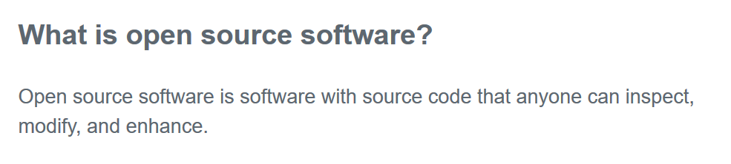
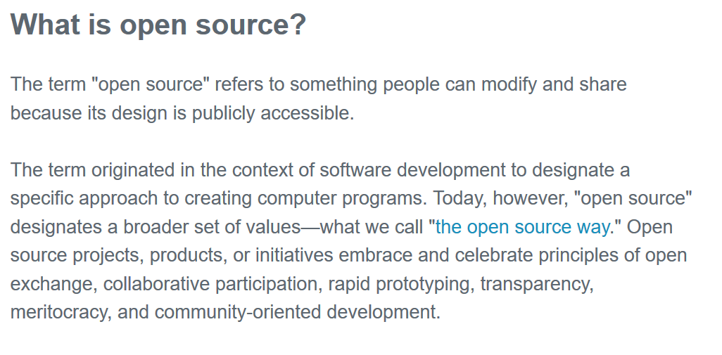
Open-Source Software
https://opensource.com/resources/what-open-source

Slide 16
Who publishes software and why?
Commercial Software: From a company
Why?
Profit
Notes
Sometimes a “free sample”
Pay attention to licensing agreements
Someone gets paid to improve and maintain this stuff

Slide 17
Who publishes software and why?
Open Source: Could be anyone.
Why?
Transparency
Serve public good
Share effort of development
Not worth fighting about
Notes
Someone still needs to get paid to work on it
→ often someone who gets paid anyway

Slide 18
Software Licensing
Commercial Licenses
Permanent use
Software as a service
Open-Source Licenses
Permissive -- do what you want, just attribute
Copy-Left – must share back
Choosing and use a license:
https://github.com/blog/1530-choosing-an-open-source-license

Slide 19


Finding a home for collaborative projects
http://www.numfocus.org/
http://zephyrtransport.org/

Slide 20
Some Open-Source Software Resources (start from the top)
1. Python Standard Library
https://docs.python.org/3/library/
2. Python Open Data Science Stack
http://pydata.org/downloads.html
3. Anaconda Packages
https://docs.continuum.io/anaconda/pkg-docs
- Anaconda Navigator installed on your computer
- From command prompt: conda install <package name>

Slide 21
Some Open-Source Software Resources (start from the top)
4. PyPI - the Python Package Index
https://pypi.python.org/pypi
- From command prompt: pip install <package name>
5. Github
https://github.com/
6. Specific people or organizations you are familiar with

Slide 22
A few I like or use
The starting point for this course:
https://github.com/waddell/urban-informatics-and-visualization
https://github.com/gboeing/urban-data-science
Urban Data Science Toolkit
https://github.com/UDST
osPlanning
https://github.com/osPlanning
Metropolitan Transportation Commission (MTC)
https://github.com/MetropolitanTransportationCommission
San Francisco County Transportation Authority (SFCTA)
https://github.com/sfcta

Slide 23
Sorting Through the Noise
That’s a lot of stuff!
Welcome to the 21st Century.
Why don’t you just tell us what’s good and what’s junk?
Sorry, that’s hard…
…but I’ll try to give you some help sorting through the noise.

Slide 24
Sorting through the noise…
Questions to ask
Who is providing data/software and why?
Read the ‘About’ page!
Where do the data come from? What are the potential biases/limitations of these data?
How are they processed? Can I trace back to the original source?
Is it vetted? How many users? User reviews? Peer reviewed?
What testing has the software undergone?

Slide 25
Sorting through the noise…
2. Verification and Validation
Verification: Check that the software/data does what it says it does
Validation: Check against an independent data source

Slide 26
Sorting through the noise…
3. External Evidence
Data are one form of evidence. There are others as well. What else can I bring to the table?
Start with a literature review. Some resources:
http://libguides.uky.edu/transportation
→Focus on peer-reviewed academic literature.
Consider a systematic literature review.

Slide 27
IMVAIN Source Reliability Checklist
Independent sources are preferable to self-interested sources.
Multiple sources are preferable to a report based on a single source.
Sources who Verify or provide verifiable information are preferable to those who merely assert.
Authoritative and/or Informed sources are preferable to sources who are uninformed or lack authoritative background.
Named sources are better than anonymous ones.
R. O’Connor, “Practical Tools for Teaching News Literacy,” The Learning Network - Teaching and Learning with the New York Times, 08-Oct-2014. https://learning.blogs.nytimes.com/2014/10/08/guest-post-practical-tools-for-teaching-news-literacy/

Slide 28
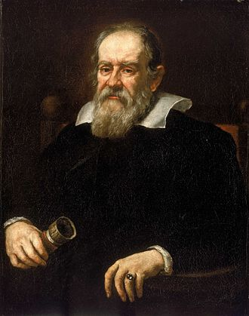
Some history…
Galileo Two New Sciences
Even with a strong scientific process, additional community-level components are required to ensure the validity and credibility of science. These include:
Data recording and sharing
Reproducibility
External review

Slide 29
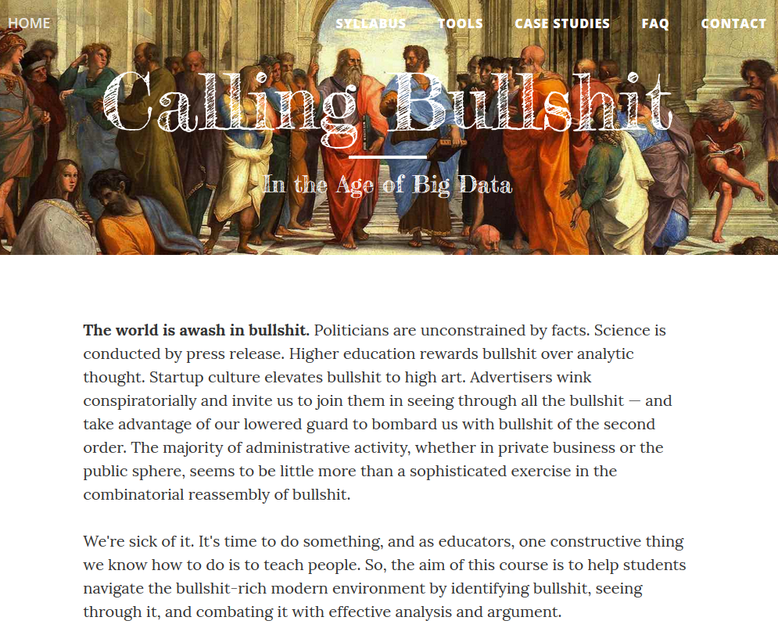
INFO 198, University of Washington
http://callingbullshit.org

